Slide 1
Hidden Slide
Select View > Notes Page for background and setup information.
Notes:
To the learning facilitator:
Thank you for choosing to prioritize education on celiac disease. With approximately 1% of Americans affected by celiac disease, it is more common than many realize. Educating all school staff members is one of the first steps to ensuring students with celiac are safe, included, and supported in school and at school-sponsored activities. Your efforts are appreciated by many in the celiac community!
In the spirit of supporting true learning and development, this training is designed to be interactive. Participants will be asked to engage with each other, you, and their own ideas throughout the training.
The length of the training is approximately 1 hour. Learners will gain the most from completing the training in its entirety. If you do not have 1 consecutive hour available, the training can also be completed in two 30-minute sessions. There is a note on page 30 to indicate the ideal point to split the training in two.
Please read the following notes carefully as you prepare to facilitate what will hopefully be a very worthwhile learning experience.

Slide 2
Hidden Slide
Select View > Notes Page for background and setup information.
Notes:
First, some assurances:
If you are not familiar with celiac disease, have no fear! The facilitator notes have been designed with the non-expert in mind: After all, very few people are experts on celiac disease. Celiac disease has many nuances, and even caregivers of and people with celiac disease continue to learn as they go.
If you are new to facilitating professional development, rest assured that the notes have been designed with you in mind as well. By using icons, text features, and clear instructions, the notes seamlessly guide you through each step.
As a bonus, the learners will be doing most of the work; consequently, they will learn more, and you will have moments to breathe.
For the best possible results, here are steps for you to take in preparation for the training:
Step 1: Print the facilitator notes (preferably in color).
Rather than reading the notes in Presenter View on the computer screen, it is advised that you have the notes printed in order to a) have the icons visible for quick reference, and b) free yourself from the computer, move around the room, and engage with learners.
Step 2: Print and copy the learner packets.
Print one copy of the learner packet for each learner (document titled “Celiac Disease for Schools Learner Activities Packet”).
It is recommended that learners fill out the supplemental materials on paper, rather than electronically, in order to avoid distractions that frequently come with open computers at meetings. Of course, exceptions can be made for those with manual dexterity challenges.
If learners would like an electronic version of the materials, you can send it to them following the training.

Slide 3
Hidden Slide
Select View > Notes Page for background and setup information.
Notes:
Step 3: Read through the facilitator notes while referencing the supplemental materials.
As you read, you’ll notice the following quick-reference visuals:
X mins. = how many minutes (approximately) the activities associated with that slide should take.
+ bold, italic letters = things you will say (word-for-word or paraphrased)
= things you will do
= important information for you
= alternate activity for the whole group if mobility limits any learners from participating in the original version of the activity
If a line does not have an icon next to it, the most recent icon still applies.
For quick reference, each time a page from the learner packet is mentioned, that page number is in bold green text (i.e. page 2).
As you read, consider any special needs of your learners (visual impairment, manual dexterity, etc.) and how you will accommodate their needs so they can fully participate. You may want to make notes in the margins.
Step 4 (optional): Tailor the scenario activity to your learners.
On page 39, you’ll see a scenario for learners to talk through. It is intended to be representative of a general situation commonly found in classrooms of many grade levels and content areas. If, however, you feel that your learners will benefit from a scenario more tailored to their specific roles, feel free to edit the slide with a scenario you create.

Slide 4
Hidden Slide
Select View > Notes Page for background and setup information.
Notes:
Step 5: Communicate with learners to let them know what to expect and what to bring. Here is a sample message:
On [day, date], we will be learning about celiac disease and how to support our students with celiac disease. This is essential learning for all members of our staff, and we look forward to expanding our understanding of celiac disease together. The training will be one hour of interactive activities. Please come prepared with a pen or pencil and be ready to participate!
Step 6: Map out the room setup.
You can do this in your mind or on paper. Learners will need a partner handy at all times, so they will need to sit in groups of 2, at a minimum. If possible, have learners sit at tables of 4 or 6.
There will be multiple occasions where learners will turn to a partner to discuss an idea. Consider whether you would like to assign seats and partners or let learners choose their own. Partners with similar job assignments may benefit from sharing ideas, as will partners whose jobs differ quite a bit. Ultimately, it is up to you and the dynamic you’d like to create during this learning experience.
Step 7: Practice
If possible, use the technology and learning space you will be using during the training. You don’t need to have people present when you practice, but walking through each step of the training will help you address any snags ahead of time. More importantly, it will help you facilitate smoothly when it’s time for the real deal.

Slide 5
Hidden Slide
Select View > Notes Page for background and setup information.
Notes:
Step 8: Gather Materials
Make sure you have the following:
1 learner packet for each learner
1 facilitator guide
1 computer with “Celiac for Schools” open in Slide Show mode
extra pens
2 packs of sticky notes for each table (optional)
Step 9: Facilitate!
You’re ready to teach your staff how to support students with celiac disease!
Step 10: Follow up
Throughout the training, someone is bound to have questions you may not feel confident answering. Please contact Valerie Kraft at Beyond Celiac with any questions. She can be reached here:
Valerie Kraft
Director of Community Engagement
Beyond Celiac
vkraft@beyondceliac.org
After receiving your answer, be sure to follow up with the individual or entire group to share.
Additionally, consider a follow-up discussion every few weeks during staff meetings. Find out what types of progress has been made and what types of hurdles have been faced. Clarify any questions and continue to advocate for your students with celiac disease.
Thank you for your advocacy and support!

Slide 6

Celiac Disease
Keeping students safe and included
Notes:
N/A
Have this slide up on the screen as learners arrive.
Greet learners as they arrive and ensure that they take seats according to the seating arrangement you planned.
When it is time for training to begin, move forward to the next slide.

Slide 7
Welcome!
Notes:
1 min.
Welcome learners and introduce yourself if needed.
Check that all learners are seated according to your seating arrangement.

Slide 8

How does this apply to me?
Notes:
2 mins.
We’re here today to learn about celiac disease. You may know a little bit about it, a lot, or nothing at all. As we begin, what’s most important to know is that it’s a condition that impacts many facets of life: physical, social, and emotional.
Even if you don’t work directly with a student who has celiac disease right now, you can still play a role in positively impacting a student’s school experience by applying what you learn here today.
Have learners turn to page 1 in their packet.
On this page, under question #1, you’ll take one minute to begin a list of ways you can play a role in supporting any student with special healthcare needs. We will complete #2 later in the training.
Give learners one minute to begin their list. They may work alone or share ideas with others at their table.
Examples: Advocate for inclusive practices, raise awareness, address social and learning barriers, address extracurricular barriers

Slide 9
What is celiac disease?
1) a wheat allergy
2) an autoimmune disorder
3) a diet fad
4) I don’t know
Notes:
1 min.
What is celiac disease? Please take a couple seconds to silently read the answer options.
Allow learners a few seconds to read the slide.
Think about your answer, but don’t say it out loud yet. You will be moving to a designated area of the room with others who have the same answer.
Point out which designated area (i.e. by the bookshelf, in the back corner, etc.) they should go to for option 1, for option 2, and so on.
Please move to your designated area.
If there is a mobility challenge in the group, have everyone remain in their seats and hold up the correlating number of fingers to show which answer they choose.
Call on one person from each group to explain why they chose what they did. Be careful not to indicate whether their answer is right or wrong.

Slide 10

Celiac disease is an autoimmune disorder.
Triggered by ingesting a protein called gluten
Found in
wheat
barley
rye
Notes:
<1 min.
Celiac disease is an autoimmune disorder, triggered by ingestion of a protein called gluten. Gluten is found in wheat, barley, and rye.

Slide 11
People with celiac disease only need to be careful about foods and beverages.
1) True
2) False
Notes:
1 min.
True or False: People with celiac disease only need to be careful about foods and beverages. Again, be thinking about your answer, but don’t say it out loud yet.
Point out which designated area learners should go to if their answer is “true,” and where they should go if their answer is “false.”
Please move to your designated area.
If there is a mobility challenge in the group, have everyone remain in their seats and hold up 1 finger if their answer is “true,” or 2 fingers if their answer is “false.”
Call on one person who answered “false” and ask them to explain why they answered that way.

Slide 12


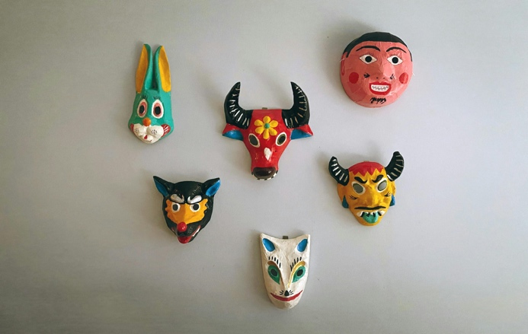


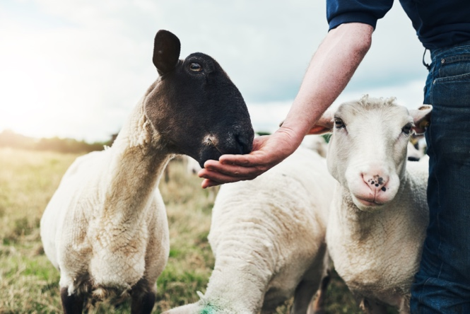

False!
Gluten is all around us.
Notes:
1 min.
That statement was false. Gluten can be found in a wide variety of non-food products. While gluten cannot be absorbed through the skin, if there is a way it can get into the mouth or nose of someone with celiac, it can find its way into their digestive tract and cause a reaction.
Craft materials such as Play-Doh, papier mache, and finger paints can contain gluten. When kids get these on their hands and under their nails, they run the risk of ingesting gluten when they eat, bite their nails, or simply stick their fingers in their mouths.
Body care products such as lip balm and lotion can contain gluten. Because they have the potential to run into the mouth or get onto hands, some people with celiac disease choose to use only gluten-free body-care products.
Gluten can also be airborne in flour and dust from animal feed. If you can breathe it in, you can swallow it.

Slide 13
Similar to an EPIPEN® used for many food allergies, people with celiac disease can take medication to stop the reaction when they accidentally ingest gluten.
1) True
2) False
Notes:
1 min.
True or false: Similar to an Epipen used for many food allergies, people with celiac can take medication to stop a reaction when they accidentally ingest gluten.
Point out which designated area learners should go to if their answer is “true,” and where they should go if their answer is “false.”
Please move to your designated area.
If there is a mobility challenge in the group, have everyone remain in their seats and hold up 1 finger if their answer is “true,” or 2 fingers if their answer is “false.”
Call on one person who answered “false” and ask why they answered that way.

Slide 14
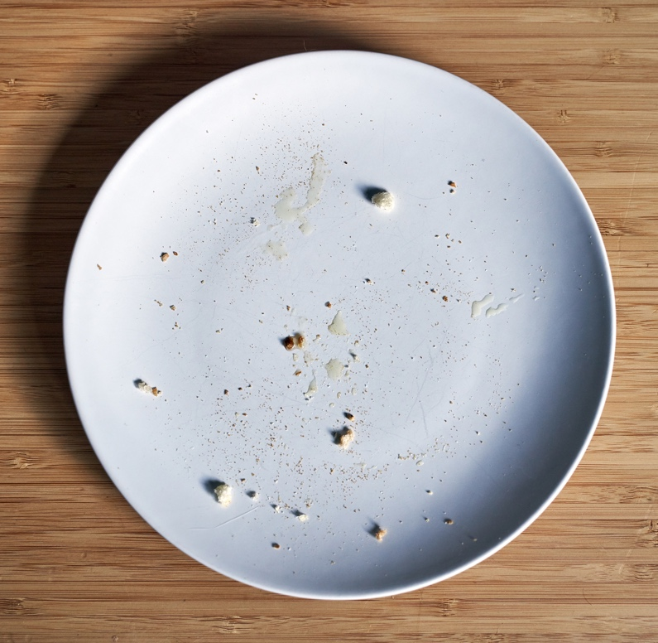
False!
The only treatment for celiac disease is the gluten-free diet.
Notes:
< 1 min.
This is false. The only treatment for celiac disease is the gluten-free diet. This means preventing people with celiac disease from ingesting gluten with a strict, lifelong diet and careful management of the environment.
Even one crumb of gluten-containing bread is enough to cause a reaction in some people with celiac disease.
Reactions vary from person to person.
Have learners return to their seats before you move forward to the next slide.

Slide 15


ABDOMINAL PAIN
IRRITABILITY
BLOATING
MIGRAINE
MUSCLE PAIN
VOMITING
JOINT PAIN
CONSTIPATION
FATIGUE
ANXIETY
NAUSEA
DIARRHEA
GAS
BRAIN FOG
SKIN RASH
Gluten Exposure
Notes:
< 1 min.
What happens when a person with celiac disease ingests gluten?
Click forward to reveal each symptom one at a time on the screen.
Ask a learner to read each symptom aloud for the group when it pops up.
Symptoms can last for hours, days, or even weeks. It is important to keep this in mind when accommodating a student’s needs relating to bathroom trips, nurse visits, mental health, and absences.
Symptoms vary among individuals with celiac disease. Some people may have more gastrointestinal symptoms: bloating, abdominal pain. Others may have symptoms like anxiety, rash or fatigue. It’s important to keep this in mind when you have more than one student with celiac disease. The needs of Student A aren’t necessarily going to mirror the needs of Student B. Symptom type, severity, and duration will vary between individuals.

Slide 16

Asymptomatic Celiac Disease =
No noticeable symptoms of exposure
Notes:
1 min.
Some people with celiac disease don’t have any outward symptoms at all. We call this asymptomatic celiac disease.
However, and this is key to remember: the severity of symptoms does not correlate with the severity of the disease or internal damage. Mild symptoms do not mean that someone has “mild damage” or a “mild case of celiac disease.” Every person with celiac disease, regardless of symptoms, will experience internal damage when they ingest gluten.

Slide 17
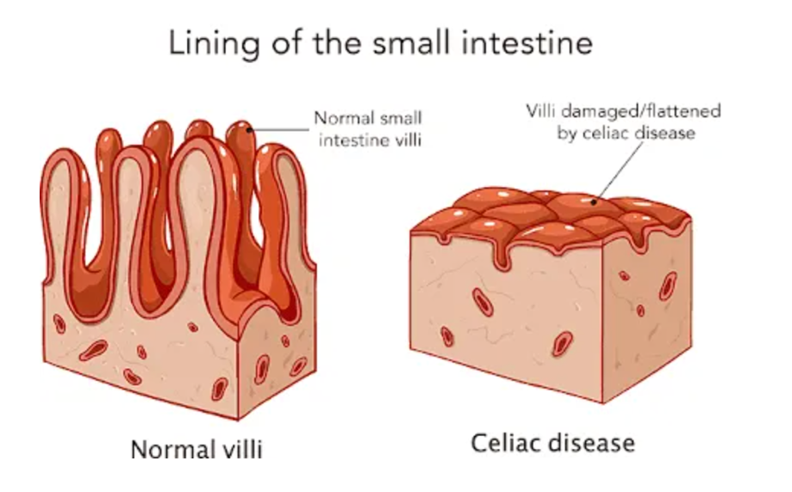
Long-Term Effects of
Repeated Gluten Exposure
ANEMIA
DENTAL ISSUES
INTESTINAL CANCERS
OSTEOPOROSIS
OTHER AUTOIMMUNE DISEASES
INFERTILITY
SHORT STATURE
Notes:
1 min.
Inside all individuals with celiac disease, the same thing is happening during gluten exposure: The immune system attacks the small intestine. The villi, which assist in absorbing nutrients from food, get damaged. The body then cannot absorb nutrients as needed. Over time, the inflammation this immune reaction creates and the damage to the small intestines can lead to additional problems.
Repeated gluten exposure can lead to bigger problems, including:
Click forward to reveal each condition one at a time.
Ask a learner to read each condition out loud for the group when it pops up.

Slide 18
1) pancakes
2) Play-Doh
3) apple slices
4) tater tots
5) moisturizer
6) all of the above
In which of the following items could gluten potentially be found?
Notes:
1 min.
Now we have a multiple-choice question: In which of the following items could gluten potentially be found?
Read the options aloud.
Please hold up the number of fingers that correlate with your answer choice. So, if you think 3 is the correct answer, hold up three fingers.
Allow a few seconds for learners to show their answers, but don’t reveal the correct answer yet.
Now, turn to a partner next to you, and take turns sharing why you answered how you did.
Allow about 30 seconds for partners to share with each other.

Slide 19





6) All of the Above!
Notes:
3 mins.
The answer is number six, all of the above!
Click forward to reveal each of the first three pictures one at a time. Stop at each picture and ask if any volunteers can share why that item would contain gluten. If no one knows, share the answers with the group.
Pancakes = traditionally made with wheat flour
Play-Doh = made with wheat flour
Moisturizer = Gluten-containing ingredients, usually wheat, can be used in body products for their moisturizing, emulsifying, and stabilizing properties.
Click forward to reveal the pictures of the apples and tater tots.
The first three items make sense, but what about these two? Why would they contain gluten? Brainstorm ideas with your partner.
Give partners about one minute to discuss.
Bring the group back together and ask for a few volunteers to share their ideas with the group.

Slide 20

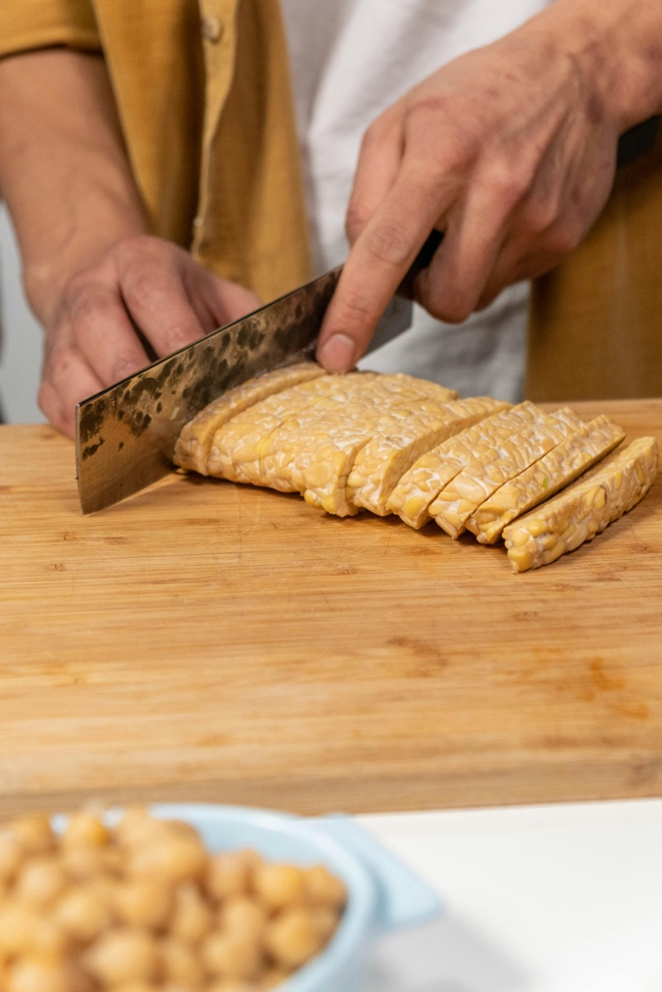
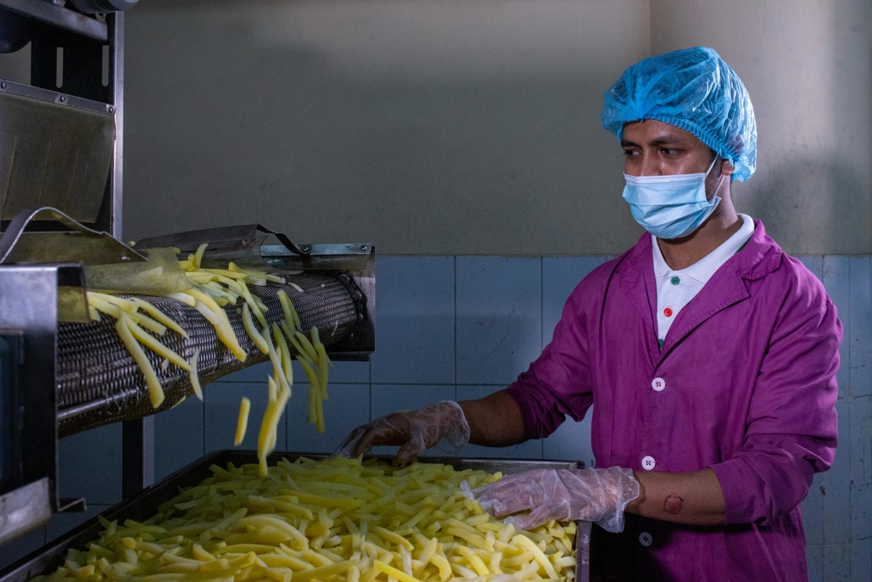
“Cross-Contact” from <a href="https://www.textstudio.com/">Font generator</a>
Notes:
1 min.
Something called cross-contact is the culprit here. Cross-contact is when a food allergen is inadvertently transferred from one food to another.
This is similar to cross-contamination with raw meat. We all know not to put anything on a cutting board that we just used to cut raw chicken. Even though they are invisible, dangerous bacteria can still be lurking.
This goes for gluten, too. It can be left behind on plastic and wooden cutting boards, on knives, and on cooking utensils if they are not washed thoroughly. If a parent cuts a sandwich on a cutting board and then cuts apples on the same surface as a healthy snack for the class, these apple slices could make the student with celiac disease sick because of cross-contact.
The same goes for anything fried or cooked in the same oil. For example, if someone fries chicken tenders in oil and then puts tater tots into the same oil, the tater tots are no longer gluten-free.
Heat doesn’t “kill” gluten. It’s not a virus or bacteria or a living, it’s a part of food.

Slide 21
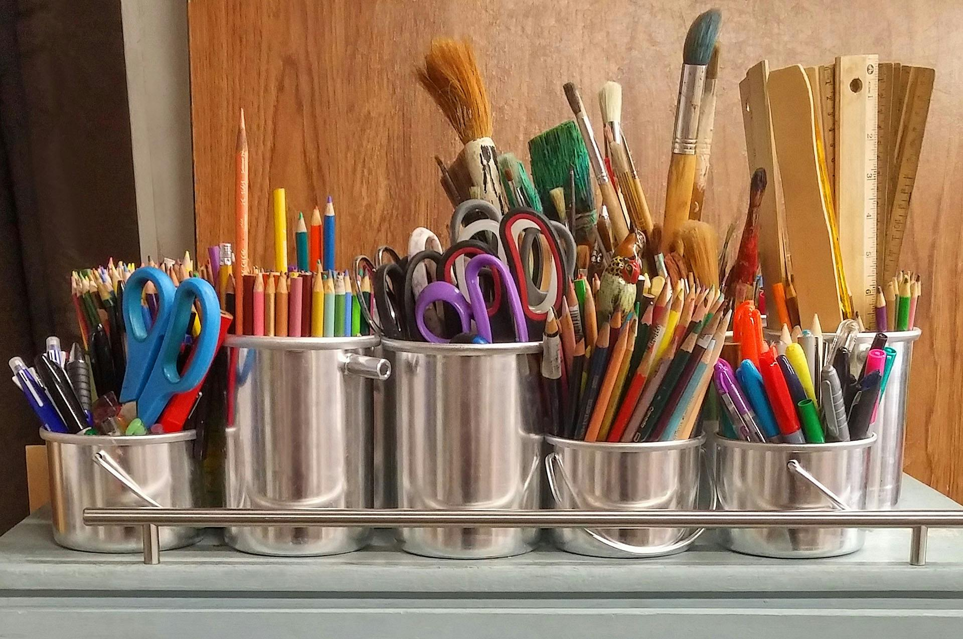
“Cross-Contact” from <a href="https://www.textstudio.com/">Font generator</a>
Notes:
2 mins.
Take a second to look at this picture. How could cross-contact be an issue here?
Briefly jot your ideas under #1 on page 2 in your packet.
Allow about 30 seconds for learners to individually write down their ideas.
Now, take a minute to share your ideas with your partner.
Give partners one minute to discuss.

Slide 22






“Cross-Contact” from <a href="https://www.textstudio.com/">Font generator</a>
Notes:
< 1 min.
In any environment, anyone who has gluten protein on their hands has the potential to leave traces of it on surfaces. The student with celiac disease then picks it up when touching that surface. If their fingers go into their nose or mouth without having washed their hands first, they could have a reaction.
Click to reveal the arrow going from the pretzel to the mouth.
This is a roundabout-yet-real way that people with celiac can ingest gluten.

Slide 23
Throughout the school, what can we do to keep our students with celiac disease safe from cross-contact?
Notes:
4 mins.
Knowing that the potential for cross-contact exists throughout the school, what can we do to keep our students with celiac safe?
Take a couple minutes to brainstorm ideas with your partner. In your packets under #2 on page 2, write at least three potential strategies to reduce the chances of a gluten exposure due to cross-contact. These can be strategies you will use personally or strategies the school can use on a larger scale.
Give partners two minutes to brainstorm and write their ideas.
Take one or two minutes to have volunteers share their ideas with the whole group.
If any learners share ideas that involve isolating the student with celiac to their own seat in the cafeteria or classroom, encourage them to think of alternate options that keep the student included with their peers. Their inclusion is just as important as their safety.

Slide 24
Reducing Gluten Exposure via Cross-Contact
Child with celiac disease washes hands before eating
Thoroughly clean the eating space of the child with celiac disease
All students wash hands after eating or using gluten-containing materials
All tables and counters washed immediately after students eat or use gluten-containing materials
For flexible or shared seating, all desks and counters washed at least once per day
Notes:
2 mins.
I’m going to share some strategies that you may have already brainstormed and some that may be new. As we read through these, please add to your list on page 2 by noting the strategies that apply directly to you.
Click forward to reveal each strategy one at a time, reading each one aloud.
Note that when cleaning surfaces for the child with celiac disease, the rag and bucket with soap and water should be free of any gluten-containing food or materials. Sometimes this requires two wipe-downs: one to remove gluten crumbs, and one with a fresh rag to thoroughly clean.
Ask learners if they have any questions about how to apply these strategies in their daily routine.

Slide 25

What about hand sanitizer?
Notes:
< 1 min.
What about hand sanitizer? Is this a viable option to eliminate gluten on hands?
Pause just long enough for learners to give it some thought.

Slide 26

Notes:
< 1 min.
No, it is not a viable option. While hand sanitizer does kill germs, it does not eliminate the gluten protein on hands. Gluten cannot be “killed” like bacteria. Soap and water is the best way to remove gluten from hands.

Slide 27
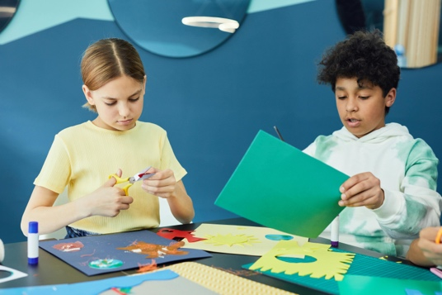
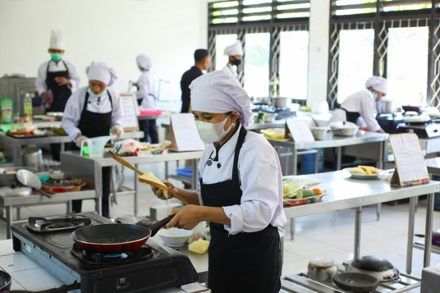



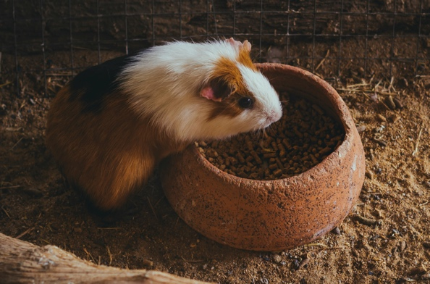
Where can gluten be found in school materials?
art & craft materials
culinary arts
sensory bins
science
food for class pets
hand soap
Notes:
4 mins.
Where else can gluten be found in the school setting?
Reveal images one at a time, naming each image aloud.
Can you think of anywhere else gluten could potentially be found in our school? Think of materials students could get on their hands, on their face, in their mouths, or inhale.
Have volunteers share answers.
If volunteers share an answer you’re not sure about, point out that they successfully mastered the first step, which is wondering if something has gluten. Celiac disease patients and caregivers do this all the time. The next step is looking it up, or in the case of a student, checking with the parent (or student if they’re old enough to know).
Given the potential for gluten to be just about anywhere, how can we keep our students with celiac disease safe and included? Work with your partner to brainstorm a list of ideas on page 3 of your packet.

Slide 28
Equal Access to Learning
Most Inclusive Option:
Provide gluten-free (GF) supplies for all students.
Notes:
1 min.
As I share strategies on the screen, please add them to your list on page 3 if you don’t already have them. Add a star to the strategies that are directly applicable to you in your position.
Click to reveal the first strategy.
The best possible strategy is to purchase gluten-free materials for everybody. When it is possible within the scope of budget and time, this is the best way to keep students with celiac disease safe while also ensuring that they are fully included.
Remember that even though gluten cannot be absorbed through the skin, it can be ingested if it is on the hands or under the nails, then the student eats something or puts their hands in their nose or mouth.

Slide 29
Equal Access to Learning
Most Inclusive Option:
Additional Options:
GF supplies for student
Gloves for student
Clean all surfaces
Thorough hand washing
Provide gluten-free (GF) supplies for all students.
Notes:
2 mins.
Click forward to reveal and read each strategy one at a time.
When that isn’t possible, the following strategies also ensure that students receive the same educational opportunities as their peers:
Provide GF supplies for the student.
If okayed by parents, have student wear gloves while handling gluten-containing materials and wash hands immediately after.
Clean all surfaces after other students are done using gluten-containing materials.
Have all students wash hands after using gluten-containing materials
Are there any other strategies you came up with that you’d like to share?
Call on a few volunteers to share their strategies.

Slide 30


Airborne Gluten
Notes:
2 mins.
Another occasional place gluten is found is in the air. If gluten is inhaled, it can find its way to the digestive tract. For this reason, it is essential that students are breathing air that is free of gluten.
Take flour, for example. Once released into the air, flour particles can take 12-24 hours to settle. If you have one class making salt-dough art, and a student with celiac disease is in your classroom one hour later, this could be an unsafe environment for them.
As I previously mentioned, it can even be in dust stirred up from pouring dry pet food.
What is airborne in students’ spaces throughout the school? Jot your ideas on page 4 of your packet. Could gluten be in these items?
Give learners a minute to jot their ideas with or without a partner.
This is a good point to break if you are splitting this training into two 30-minute sessions.

Slide 31
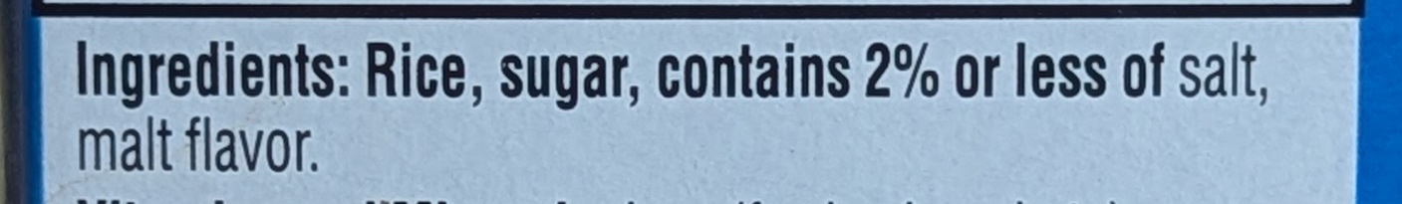
Is this food gluten free?
Notes:
1 min.
After making that list, you may be wondering, “How are we supposed to know if something contains gluten?” I’m glad you asked.
Click to reveal the image of a food label.
Take a look at this food label. Give me a thumbs up if you think this product is safe and gluten-free. Give me a thumbs down if you think it contains gluten.
Give learners a few seconds to read the label and show their thumbs.
Call on someone with their thumb down to explain why they think this contains gluten.
Click forward to reveal the circled ingredient.
Gluten is found in wheat, barley and rye. Wheat is a top 9 allergen in the US, so anything made from it is legally required to be called out as such on a product label. However, the words “gluten,” “barley,” and “rye” are rarely listed as such, even when used. In this case, “malt flavor” is a derivative of barley, and thus contains gluten. So this is not safe for our students with celiac disease.

Slide 32

Other Names for Gluten
Contains Gluten
May Contain Gluten
einkorn
emmer
kamut
spelt
bulgur
graham
malt
malt extract
malt flavoring
malt vinegar
maltose
brewer’s yeast
matzo
couscous
seitan
emmer
farro
Dinkel
triticale
semolina
durum
farina
oats
natural flavor
artificial flavor
seasonings
flavorings
dextrin
modified food starch
vegetable starch
vegetable protein
hydrolyzed plant protein
hydrolyzed vegetable protein
The lists go on…
Notes:
1 min.
These are some of the names that wheat, barley, and rye go by.
A special note on oats, which are naturally gluten-free but often contain gluten due to cross-contact during processing. The only oats considered safe for individuals with celiac are oats that are certified gluten-free.

Slide 33

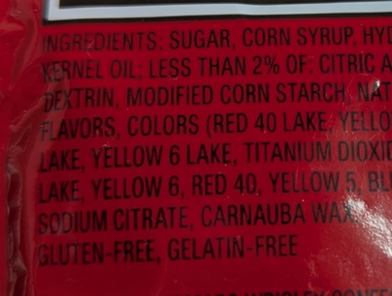





Safe
"Gluten friendly”
Questionable
“Made without gluten”
Notes:
1 min.
Click forward to reveal the images and notes in green.
The words “gluten free” on sealed, manufactured items are generally trustworthy. There is no standard logo or location where you might find these words, but if you can find them, they should be safe.
Additionally, single or few ingredient products are considered safe—so, a bag of potatoes, or a container of yogurt sweetened with honey. The safest option will always be a product labeled gluten-free, but there are plenty of safe options that aren’t labeled gluten-free; a bunch of bananas will rarely say “gluten-free,” but it’s a great snack option!
Click forward to reveal the images and notes in yellow.
The words “gluten free” on a restaurant or bakery menu are worthy of questioning. Because the FDA does not regulate these practices like they do manufactured items, their safety cannot be assumed. Additionally, the phrases “gluten-friendly” or “made without gluten” indicate that the restaurant or manufacturer may not ensure celiac-safe practices, and it is best to ask questions first.

Slide 34
Always be sure to
Follow the specifics in the student’s plan (504, IHP, or IEP)
Treat tactile materials like food (check their safety)
Ask questions if you have any uncertainty
Notes:
1 min.
Still, there are nuances. More than we have time for. The topic of gluten-free labeling is so complex, it warrants its own training. Do not attempt to take this on alone and become an expert in reading labels.
Instead, do the following when checking the gluten-free status of learning materials, airborne materials, or food:
Follow the specifics written in the student’s plan. They may have a 504 plan, an individualized health plan, or an IEP that includes their health-related needs.
Remember to treat tactile and airborne materials like food.
When in doubt, ask the student’s primary caregivers. You can also discreetly ask the student if their caregivers have confirmed that they understand celiac disease well enough to answer questions.
Many caregivers would prefer that you involve them in deciding whether or not the product is safe for the child. Never hesitate to ask.

Slide 35
Celiac Disease and
Mental Health
34% of kids with celiac have a mental health disorder
13% of the general pediatric population has a mental health disorder
Why?
Notes:
2 mins.
Now that we’ve covered the physical needs of students with celiac, let’s talk about their mental health needs.
Click to reveal the first fact and read it aloud.
Click to reveal the second fact and read it aloud.
So this second stat comes from one study, which found that kids with celiac disease may be more likely to have mental health disorders than the general population. This statistic is staggering. More research is needed to verify the connection and explore potential reasons, but take a few seconds to think about why so many kids with celiac may have a mental health disorder.
After 30 seconds or so, call on a few volunteers to share with the group.

Slide 36

embarrassment
disappointment
bullying
exclusion
physical pain
awkward interactions
others who don’t “get it”
constant need to self-advocate
worry
Notes:
1 min.
Click to reveal words one at a time.
It can be embarrassing and disappointing to eat a brown bag dinner while the rest of your school softball team eats pizza on the way home from the game.
It can be stressful to tell your coach that you’re concerned the restaurant doesn’t avoid cross-contact after she thoughtfully ordered you a gluten-free pizza.
It can be nerve racking to eat that pizza out of fear that you’ll hurt her feelings, then spend the next couple hours wondering if you’re going to have a reaction.
While we don’t have a solid answer yet, researchers speculate that some contributing factors include the psychosocial factors that accompany a strict gluten-free lifestyle, along with the anxiety about avoiding gluten and potentially getting sick. There may also be a yet undiscovered link in the genes that cause celiac disease and the genes that contribute to mental health disorders.

Slide 37



Inclusion Matters
Notes:
< 1 min.
The less students with celiac disease stand out, the more they’re included, and the more confident they feel about their safety, the better.

Slide 38
“Inclusion is not a strategy to help people fit into the systems and structures which exist in our societies. It is about transforming those systems and structures to make it better for everyone. Inclusion is about creating a better world for everyone.”
- Diane Richler, Inclusion International
Notes:
< 1 min.
Diane Richler, former president of an organization called Inclusion International, once said, “Inclusion is not a strategy to help people fit into the systems and structures which exist in our societies. It is about transforming those systems and structures to make it better for everyone. Inclusion is about creating a better world for everyone.”
This is a helpful outlook to keep in mind as we walk through some scenarios.

Slide 39
Scenario:
Your class is wrapping up a unit on fractions by making salt-dough “pizzas” cut into various-sized pieces to display.
How can you make sure the student with celiac disease is both safe and included?
Notes:
5 mins.
Read the scenario from the slide.
With your table group, come up with one strategy. You can write it down or keep it in your head. Consider factors like resources, budget, time, classroom setup, etc. Remember that we need to keep airborne flour out of the room.
Give learners 3 minutes to come up with a strategy.
If possible (depending on how many groups you have), call on one person per group to share their strategy with the larger group.
If anyone suggests having the student with celiac use a different material than everyone else, remind them of the importance of inclusion.
Most inclusive options: Have everyone use GF flour, GF air-drying clay, GF modeling dough, craft paper, or another GF craft material.
Relatively inclusive option: Have dough pre-made and pre-portioned ahead of time, making GF dough separately with parent input.

Slide 40


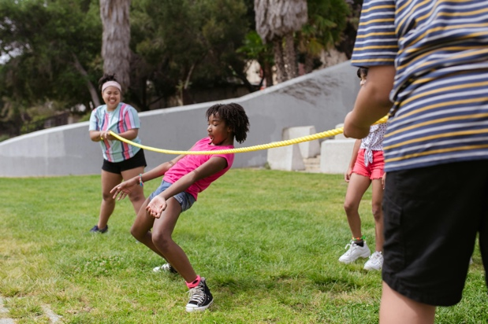

Building School Community
What are some ways that celebrations, incentives, and fundraisers can be inclusive of all students with celiac disease, food allergies, and other dietary needs?
Notes:
6 mins.
As we all know, school is the social hub for most kids. Given this, the inclusivity of social activities can have a real effect on mental health for kids with unique needs. For kids with celiac disease, social activities can be isolating when they include food. More often than not, there are few or no safe choices for them.
Sure, kids with celiac disease and other dietary needs can bring their own food for these occasions, but is that true inclusion? Not at all.
Let’s start thinking outside the box. What are some ways that celebrations and fundraisers can be both exciting and inclusive of all students with celiac disease, food allergies, and other dietary restrictions?
Work together with your group to complete page 5 in your packet.
Give learners 5 minutes to complete page X.
Call on volunteers from each group to share ideas. Suggest that learners add to their lists as they hear new ideas.

Slide 41
Social Inclusion
Social element | Who are the decision makers? | How can I create change? | What is my first step? By when?
1)
2)
3)
Notes:
4 mins.
Generating ideas is the first step, but the next is making it a reality.
Turn to page 6 in your packet. As you fill this out, consider who the major players are in contributing to these changes, and how you individually can initiate and see these changes through.
Have learners complete page 6 independently.
If time allows, have a few learners share their ideas with the group.
Hand out the “Non-food Activity Handout,” and explain that this is for staff members to keep handy and refer to whenever they need fresh ideas.

Slide 42

How does this apply to me?
Notes:
3 mins.
And lastly, let’s revisit how all of this is relevant to you and your position. Return to page 1 of your packet, where you started a list at the beginning of the training.
What else can you add to it now that you know more about celiac disease? Even if you never plan to use learning materials beyond the computer or paper, you can still play a role in keeping students with celiac disease safe and included. Jot your ideas under question #2.
Give learners two minutes to add to their list.
Call on a few learners to share their ideas. Encourage all learners to add to their list as they hear new ideas that apply to them.

Slide 43

Communicate, communicate, communicate
Notes:
1 min.
Thank participants for their time and participation.
If you remember nothing else from today, please remember that there are many nuances to celiac disease and the gluten-free diet. You’re not expected to be an expert, but you are expected to keep all students safe and included.
Remember to reach out to your resources at school and the student’s caregivers if you have any questions.
Remind learners of who their school and district resources (for example, a school nurse, a supervisor, or even yourself!) are to ensure that they are following plans appropriately and safely including students with celiac disease.

Slide 44

Questions?
Notes:
5 mins.
If there is time to answer questions, take time now to do so.
If there is not time, let learners know how they can get their questions answered. Some options:
They write the question on a sticky note (pads provided on tables by you) and stick to to the board/wall/table before leaving. You will follow up with answers.
Contact you with questions.
Contact a different school or district resource person with questions.
If there are any questions you do not know the answer to, please do not attempt to make up answers. You can contact Valerie Kraft at Beyond Celiac by emailing vkraft@beyondceliac.org.

Slide 45

Thank You!
Notes:
< 1 min.
Say goodbye and end the training.

